Slide 1
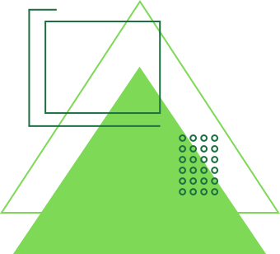
GreenSort
presented by INNOVA

Slide 2
Our Team
Sagarika Srivastava 44 231P047
Sidra Shaikh 40 231P064
Bushra Ansari 3 231P046
Sidra Solkar 43 231P087

Slide 3
ABSTRACT
An IoT-based Wet and Dry Waste Segregation Device is an intelligent system designed to automate the classification of waste into wet (organic) and dry (inorganic) categories using advanced sensor technology and machine learning. The device employs moisture sensors, infrared sensors, gas sensors, and image recognition to accurately identify waste types and direct them into the appropriate bins using motorized flaps. Integrated with microcontrollers such as Arduino, the system processes real-time data and transmits waste analytics to a cloud-based platform for monitoring and optimization. Wireless connectivity via Wi-Fi allows remote tracking of waste levels and timely collection alerts through a mobile or web-based interface. By enhancing waste segregation efficiency, reducing human effort, and promoting recycling, this IoT solution contributes to sustainable waste management in smart cities, households, industries, and public spaces.

Slide 4
components
1x Arduino uno smd
1x Servo 9g motor
1x soil moisture sensor
1x ultrasonic sensor
1x usb cable
4x 3x20mm nut and bolt
6x 3x12mm nut and bolt
20 x F-F jumpers
3 x M-F jumpers

Slide 5
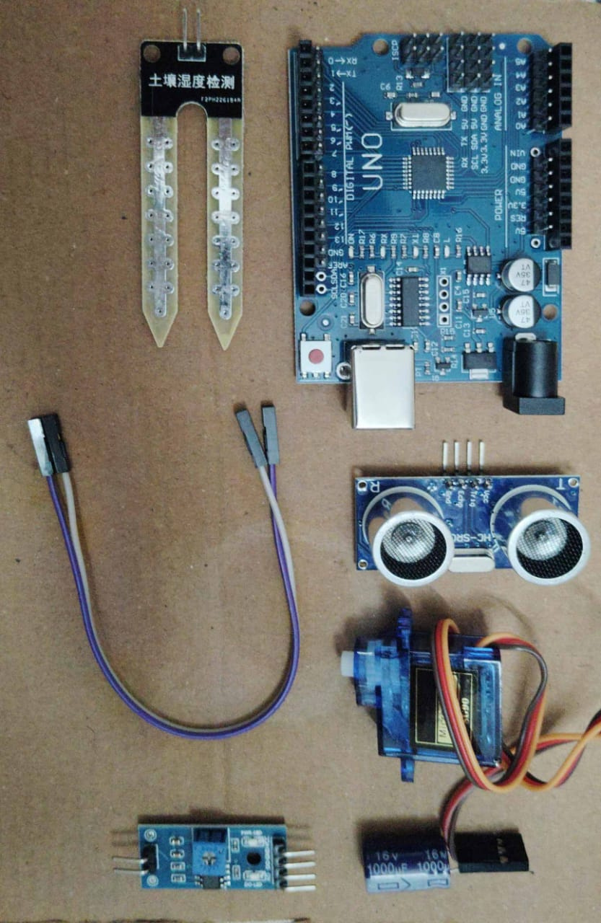

Slide 6
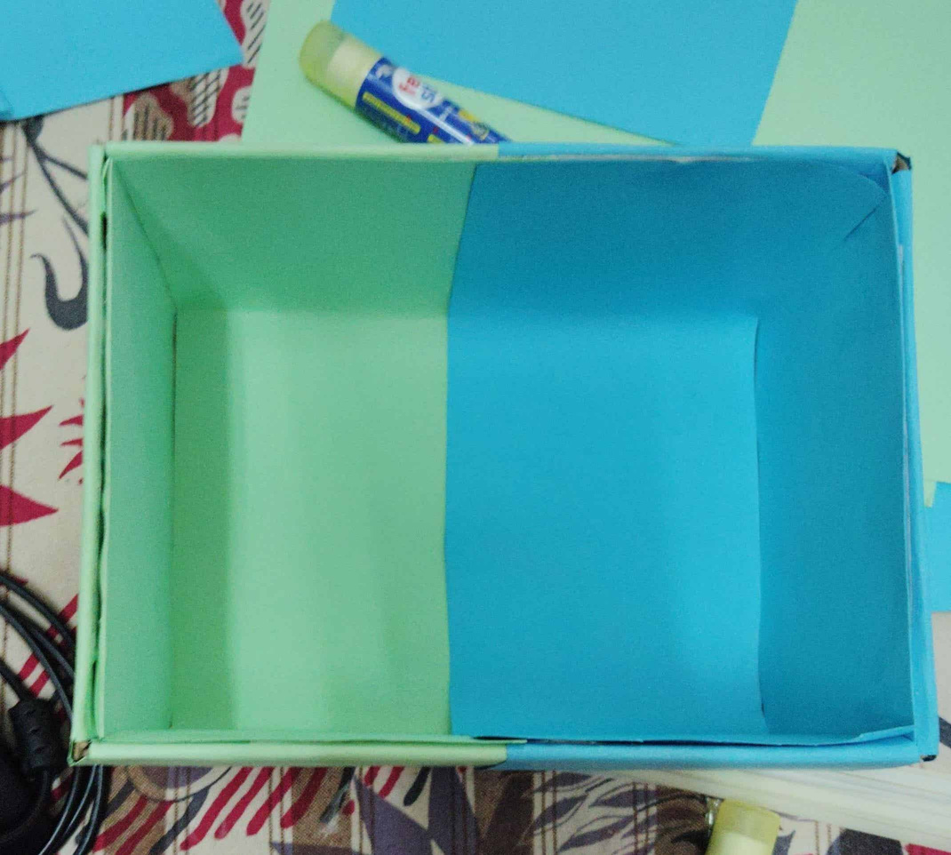
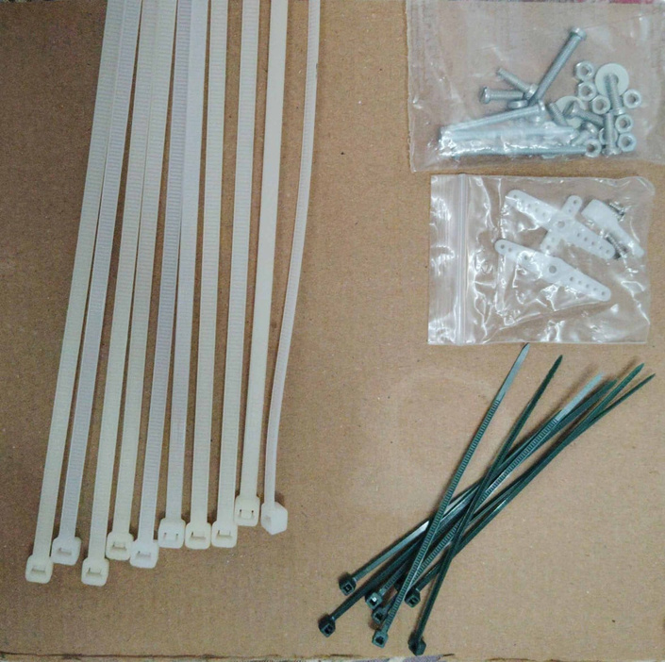

Slide 7
Thank You!

